Slide 1
Supplementary Figures
Compound cis-regulatory elements with both boundary and enhancer functions in the human genome
Daudi Jjingo¹, Jianrong Wang¹, Andrew B. Conley¹, Victoria V. Lunyak^{2,3} and I. King Jordan^{1,3}
¹School of Biology, Georgia Institute of Technology, Atlanta, GA 30332, USA
²Buck Institute for Research on Aging, Novato, CA 94945, USA
³PanAmerican Bioinformatics Institute, Santa Marta, Magdalena, Colombia

Slide 2
A
B
18
18
B-E
H3K4me1
B+E
H3K27Ac
H3K36me3
12
H3K9Ac
12
H3K4me2
Fold enrichment
H3K4me3
Fold enrichment
H4K20me1
6
H3K27me3
6
0
0
-10
-5
0
5
10
-10
-5
0
5
10
Distance in kb
P = 4.0e-7
Distance in kb
C
20
8
P = 0.022
B+E
B-E
6
15
E-B
DNAse fold enrichment
DNAse fold enrichment
4
10
5
2
0
0
B-E
B+E
E-B
-10
-5
0
5
10
Distance in kb
12
D
P = 0.01
P = 0.002
B+E
P = 0.01
60
B-E
9
E-B
45
RNA-seq fold enrichment
RNA-seq fold enrichment
6
30
15
3
0
0
B-E
B+E
E-B
-10
-5
0
5
10
Distance in kb
E
B+E around E-B
12
35
B+E around enhancers (E)
26
8
B+E fold enrichment
B+E fold enrichment
17
4
8
-10
-5
0
5
10
0
E-B
E
Supplementary Figure 1. Composite regulatory elements and their features in the human genome. Functional genomic profiles of fold enrichments of individual histone modifications around (A) simple B-E elements and (B) composite B+E elements. (C,D) Enrichment profiles and average fold enrichments for DNAse hypersensitive sites and RNA-seq reads in-and-around boundary elements (blue bars). (E) Enrichment profiles and average fold enrichments for B+E elements around solitary enhancers (E-B) in comparison to their profiles around all enhancers (E).

Slide 3
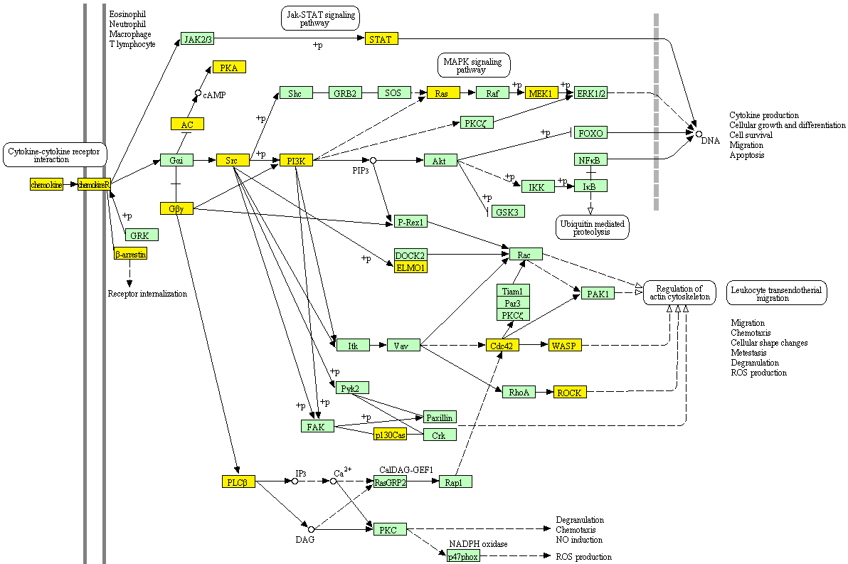
 | B+E genes | Not B+E genes | Total
Tissue-specific | 199 | 2992 | 3191
None Tissue-specific | 15 | 716 | 731
Total | 214 | 3708 | 3922
Supplementary Table 1. Association of tissue-specificity with B+E elements. A 2x2 Contingency table for Fishers' exact test of enrichment of tissue-specific genes around B+E elements (P-value=1.24e-06).
Supplementary Figure 2. Composite regulatory elements and the KEGG chemokine signaling pathway. Chemokine signaling pathway genes(yellow) located or having close homologs proximal to B+E elements.

